Slide 1
Quispamsis United Church March 24, 2024 – Palm Sunday Presider: Rev. Ian Manson Director of Music: Stephen Alexander Reader: Bob Crowley

Slide 2
Gathering Chord
As we gather to worship we take time to greet and chat with members of our church family. These reconnections are an important reminder that we share a common bond as followers of Christ.
A "Gathering Chord " serves to alert us that worship is about to begin, that we leave the hustle and bustle of our daily lives and come together as one body to worship God together.

Slide 3
Introit Gather Us In – MV 7 (X2)
Gather Us in, ground us in you.
Gather us in, ground us in you.
Gather us in, gather us in.
Ground us, ground us in you.

Slide 4
Opening Music and Prayer Candle Lighting
Centering Passage
“Help me, O God, to journey beyond the familiar and into the unknown. Give me the faith to leave old ways and break fresh ground with You.”
- A Prayer Attributed to St. Brendan

Slide 5
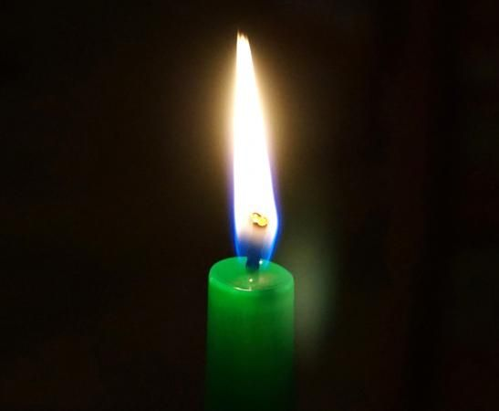
Welcome and Lighting the Christ Candle

Slide 6
As part of our welcome, we light this candle, lit from the flame of Christ’s own light and love, as we proclaim ourselves as a community where all people are invited without barriers based on age, gender, race, sexual orientation, gender identity and expression, differing abilities, ethnic background or economic circumstance.
We celebrate the richness that diversity brings to our church, even as it challenges us to walk down roads we have not yet traveled. We pray for God’s spirit to guide us as we work for reconciliation and justice for all persons in both church and society.

Slide 7
Acknowledgement of Territories
“As we gather to worship let us pause to remember that in this region we live and work and worship on lands that are, by law, the unceded territories of the Wabanaki peoples – predominantly the lands of the Mi’kmaq, Wolastoqey, Passamaquoddy and Penobscot. May we live with respect on this land and live in peace and friendship with its people.”

Slide 8
Celebrations

Slide 9
Call to Worship (Responsive)
Today, we remember the crowd that eagerly awaited the coming of Jesus, and that shouted:
Blessed is the One who comes in the name of God! Hosanna in the Highest!
Jesus’ followers were excited and filled with anticipation.
Yet within a few short days they were scattered, disillusioned and frightened.

Slide 10
Call to Worship (Responsive)
We, too, prefer to follow the Jesus who inspires crowds and rides triumphant.
We too, struggle when our hopes aren’t realized, and when we feel forsaken.
Let us turn to God for wisdom, grace and peace. Let us pray together:

Slide 11
Prayer of Approach (Unison)
God of majesty and mercy,
As we enter Holy Week and gather in your house of prayer,
turn our thoughts again to Jerusalem.
Be with us as we acclaim Jesus as Messiah.
Be with us as we watch the power of love confront the powers of the world.
Comfort us with the knowledge that you walk with us through all the joys and sorrows of life.

Slide 12
Hosanna Loud Hosanna (1/6) - VU 123
Hosanna, loud hosanna
the happy children sang;
through pillared court and temple
the lovely anthem rang:

Slide 13
Hosanna Loud Hosanna (2/6) - VU 123
to Jesus, who had blessed them,
close folded to his breast,
the children sang their praises,
the simplest and the best.

Slide 14
Hosanna Loud Hosanna (3/6) - VU 123
From Olivet they followed
'mid an exultant crowd,
the victory palm-branch waving,
and singing clear and loud;

Slide 15
Hosanna Loud Hosanna (4/6) - VU 123
the Lord of earth and heaven
rode on in lowly state,
content that little children
should on his bidding wait.

Slide 16
Hosanna Loud Hosanna (5/6) - VU 123
"Hosanna in the highest!"
That ancient song we sing,
for Christ is our Redeemer;
earth, let your anthems ring.

Slide 17
Hosanna Loud Hosanna (6/6) - VU 123
O may we ever praise him
with heart and life and voice,
and in his humble presence
eternally rejoice!

Slide 18
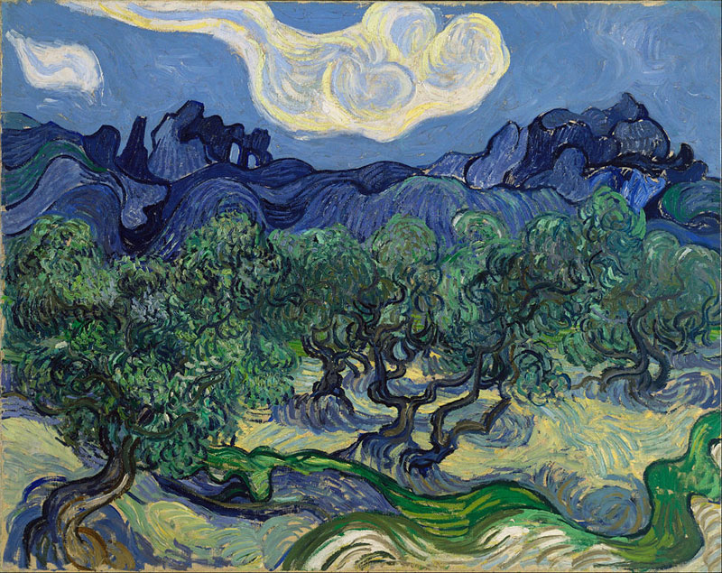
A Time of Contemplation

Slide 19
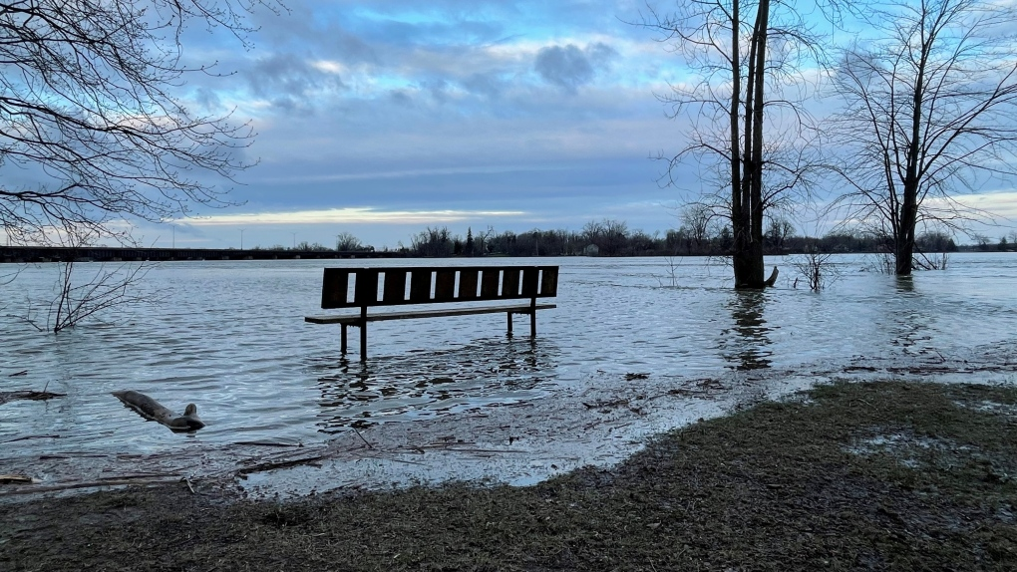
Time for All Ages

Slide 20
Time for Sunday School

Slide 21
Sung Prayer of Illumination Wonderful Words of Life – Songs of the Gospel
Speak them over again to me Wonderful words of life Let me more of their beauty see Wonderful words of life Words of life and beauty Teach me faith and duty
Beautiful words, wonderful words Wonderful words of life Beautiful words, wonderful words Wonderful words of life

Slide 22
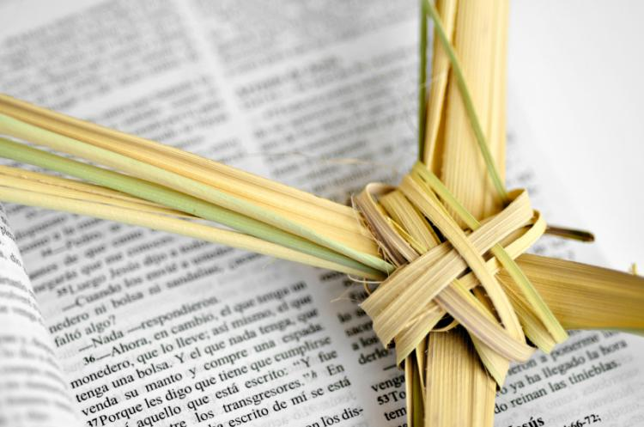
Mark 11:1-10
When they were approaching Jerusalem, at Bethphage and Bethany, near the Mount of Olives, he sent two of his disciples and said to them, ‘Go into the village ahead of you, and immediately as you enter it, you will find tied there a colt that has never been ridden; untie it and bring it. If anyone says to you, “Why are you doing this?” just say this, “The Lord needs it and will send it back here immediately.” ’

Slide 23
Mark 11:1-10
They went away and found a colt tied near a door, outside in the street. As they were untying it, some of the bystanders said to them, ‘What are you doing, untying the colt?’ They told them what Jesus had said; and they allowed them to take it. Then they brought the colt to Jesus and threw their cloaks on it; and he sat on it. Many people spread their cloaks on the road, and others spread leafy branches that they had cut in the fields.

Slide 24
Mark 11:1-10
Then those who went ahead and those who followed were shouting, ‘Hosanna! Blessed is the one who comes in the name of
the Lord! Blessed is the coming kingdom of our ancestor
David! Hosanna in the highest heaven!’
This is the Word of the Lord.
Thanks be to God.

Slide 25
The Gift of Music

Slide 26
Message A Choice of Two Parades

Slide 37
Ride On, Ride On In Majesty (1/4) - VU 127
Ride on! Ride on in majesty!
Hark! all the tribes hosanna cry;
O Saviour meek, pursues thy road
with palms and scattered
garments strowed.

Slide 38
Ride On, Ride On In Majesty (2/4) - VU 127
Ride on! Ride on in majesty!
In lowly pomp ride on to die;
O Christ, thy triumphs now begin
o'er captive death and conquered sin.

Slide 39
Ride On, Ride On In Majesty (3/4) - VU 127
Ride on! Ride on in majesty!
The wingèd squadrons of the sky
look down with sad
and wondering eyes
to see the approaching sacrifice.

Slide 40
Ride On, Ride On In Majesty (4/4) - VU 127
Ride on! Ride on in majesty!
In lowly pomp ride on to die;
bow thy meek head to mortal pain,
then take, O God,
thy power, and reign.

Slide 42
GIFTS &

Slide 43
We Give You But Your Own – VU 542
We give you but your own,
whate’er the gift may be;
all that we have is yours alone,
we give it gratefully.

Slide 44
Prayer of Dedication (Unison)
Gracious God, bless our gifts with your love so that they accomplish more than we can even imagine. Bless our lives, too, so that what we do and say will show we have the commitment to follow the way of Jesus, whatever the cost. Amen.

Slide 45
May We But Wait – MV 175
May we but wait upon Love’s word,
Knowing our prayer is heard.

Slide 46
GIFTS &

Slide 47
Sung Lord’s Prayer – VU 959
Our Father in heaven,
Hallowed be your name,
your kingdom come,
your will be done on earth as in heaven.
Give us today our daily bread.
Forgive us our sins as we forgive those
who sin against us.
Save us from the time of trial
and deliver us from evil for the kingdom,
the power and the glory are yours,
Now and forever.

Slide 48
O Jesus I Have Promised (1/4) VU 120
O Jesus, I have promised
to serve you to the end;
remain for ever near me,
my Saviour and my friend:
I shall not fear the journey
if you are by my side,
not wander from the pathway
if you will be my guide.

Slide 49
O Jesus I Have Promised (2/4) VU 120
O let me feel you near me:
the world is ever near;
I see the sights that dazzle,
the tempting sounds I hear;
my foes are ever near me,
around me and within;
but, Jesus, then draw nearer
and shield my soul from sin.

Slide 50
O Jesus I Have Promised (3/4) VU 120
O let me hear you speaking
in accents clear and still,
above the storms of passion,
the murmurs of self-will;
O speak to reassure me,
to hasten or control;
now speak, and make me listen,
O guardian of my soul.

Slide 51
O Jesus I Have Promised (4/4) VU 120
O Jesus, you have promised
to all who follow you,
that where you are in glory
your servant shall be too.
And, Jesus, I have promised
to serve you to the end:
O give me grace to follow,
my Saviour and my friend.

Slide 52
Commissioning (Responsive)
As we continue our journey through the season of Lent, and prepare to enter Holy Week,
let us remember the words of the prophet Micah:
What does the Lord require of us?
To do justice, to love kindness, and to walk humbly with our God.

Slide 53
BENEDICTION

Slide 54
We Shall Go Out With Hope (1/4) - VU 586
We shall go out
with hope of resurrection;
we shall go out,
from strength to strength go on;
we shall go out
and tell our stories boldly;
tales of a love that will not let us go.

Slide 55
We Shall Go Out With Hope (2/4) - VU 586
We'll sing our songs
of wrongs that can be righted;
we'll dream our dream
of hurts that can be healed;
we'll weave a cloth
of all the world united
within the vision
of new life in Christ.

Slide 56
As the service draws to a close you are invited to think on how God has spoken to you today while enjoying the closing music.
It is a joy to worship together, join us next Sunday… and bring a friend!

Slide 57
Closing Music
All Glory, Laud and Honour
- Georg Friedrich Kaufmann

